Slide 1

MATH30
Probability and Statistics

Slide 2
Stem and Leaf Plot
Consider the data of Table 1.1, which specifies the “life” of 40 similar car batteries recorded to the nearest tenth of a year.
Table 1.1 Car Battery Life
2.2 | 4.1 | 3.5 | 4.5 | 3.2 | 3.7 | 3.0 | 2.6
3.4 | 1.6 | 3.1 | 3.3 | 3.8 | 3.1 | 4.7 | 3.7
2.5 | 4.3 | 3.4 | 3.4 | 2.9 | 3.3 | 3.9 | 3.1
3.3 | 3.1 | 3.7 | 3.7 | 3.2 | 4.1 | 1.9 | 3.4
4.7 | 3.8 | 3.2 | 3.2 | 3.9 | 3.0 | 4.2 | 3.5

Slide 3
Stem and Leaf Plot
First, split each observation into two parts consisting of a stem and a leaf such that the stem represents the digit preceding the decimal and the leaf corresponds to the decimal part of the number. In other words, for the number 3.7 the digit 3 is designated the stem and the digit 7 is the leaf. The four stems 1, 2, 3, and 4 for our data are listed consecutively on the left side of a vertical line in Table 1.2; the leaves are recorded on the right side of the line opposite the appropriate stem value.
Table 1.2 Stem and Leaf Plot of Battery Life
Stem | Leaf | Frequency
1 | 69 | 2
2 | 25669 | 5
3 | 0011112223334445567778899 | 25
4 | 11234577 | 8

Slide 4
Double-Stem and Leaf plot of Battery Life
The stem and leaf plot of Table 1.2 contains only four stems and consequently does not provide an adequate picture of the distribution. To remedy this problem, we need to increase the number of stems in our plot. One simple way to accomplish this is to write each stem value twice on the left side of the vertical line and then record the leaves 0, 1, 2, 3, and 4 opposite the appropriate stem value where it appears for the first time; and the leave 5, 6, 7, 8, and 9 opposite this same stem value where it appears for the second time. This modified double-stem and leaf plot is illustrated in Table 1.3, where the stems corresponding to leaves 0 through 4 have been coded by the symbol * and the stem corresponding to leaves 5 through 9 by the symbol ·.

Slide 5
Double-Stem and Leaf plot of Battery Life
Table 1.3 Double-Stem and Leaf Plot of Battery Life
Stem | Leaf | Frequency
1· | 69 | 2
2* | 2 | 1
2· | 5669 | 4
3* | 001111222333444 | 15
3· | 5567778899 | 10
4* | 11234 | 5
4· | 577 | 3

Slide 6
Double-Stem and Leaf plot of Battery Life
In any given problem, we must decide on the appropriate stem values. This decision is made somewhat arbitrarily, although we are guided by the size of our sample. Usually we choose between 5 and 20 stems. The smaller the number of data available, the smaller is our choice for the number of stems.
Example:
The data consist of numbers from 1 to 21 representing the number of people in a cafeteria line on 40 randomly selected workdays and we choose a double-stem and leaf plot, the stems would be 0*, 0·, 1*, 1·, and 2* so that the smallest observation 1 has stem 0* and leaf 1, the number 18 has stem 1· and leaf 8, the largest observation 21 has stem 2* and leaf 1.

Slide 7
Double-Stem and Leaf plot of Battery Life
If the data consist of numbers from $8800 to $9600 representing the best possible deals on 100 new automobiles from a certain dealership and we choose a single-stem leaf and plot, the stems would be 88, 89, 90,…, and 96 and the leaves would now each contain two digits. A car that sold for $9385 would have a stem value of 93 and the two-digit leaf 85. Multiple-digit leaves belonging to the same stem are usually separated by commas in the stem and plot. Decimal points in the data are generally ignored when all the digits to the right of the decimal represent the leaf. Such was the case in Tables 1.2 and 1.3. However, if the data consist of numbers ranging from21.8 to 74.9, we might choose the digits 2, 3, 4, 5, 6, and 7 as our stems so that a number such as 48.3 would have a stem value of 4 and a leaf of 8.3.

Slide 8
Frequency distribution
The data, grouped into different classes or intervals, can be constructed by counting the leaves belonging to each stem and noting that each stem defines a class interval. In Table 1.2 the stem 1 with 2 leaves defines the interval 1.0−1.9 containing 2 observations; the stem 2 with 5 leaves defines the interval 2.0−2.9 containing 5 observations; the stem 3 with 25 leaves defines the interval 3.0−3.9 with 25 observations; and the stem 4 with 8 leaves defines the interval 4.0−4.9 containing 8 observations.
For the double-stem and leaf plot of Table 1.3 the stems define the seven class intervals 1.5−1.9, 2.0−2.4, 2.5−2.9, 3.0−3.4, 3.5−3.9, 4.0−4.4, and 4.5−4.9 with frequencies 2, 1, 4, 15, 10, 5, and 3, respectively. Dividing each class frequency by the total number of observations, we obtain the proportion of the set of observations in each of the classes.

Slide 9
Frequency distribution
Table 1.4 Relative Frequency Distribution of Battery Life
Class Interval | Class midpoint | Frequency, f | Relative frequency
1.5−1.9 | 1.7 | 2 | 0.050
2.0−2.4 | 2.2 | 1 | 0.025
2.5−2.9 | 2.7 | 4 | 0.100
3.0−3.4 | 3.2 | 15 | 0.375
3.5−3.9 | 3.7 | 10 | 0.250
4.0−4.4 | 4.2 | 5 | 0.125
4.5−4.9 | 4.7 | 3 | 0.075

Slide 10
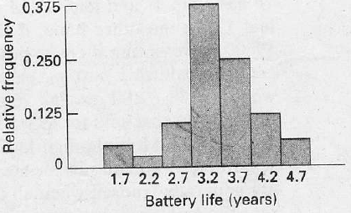
Relative Frequency Histogram
Figure 1.4 Relative frequency histogram.

Slide 11
Relative Frequency histogram
Many continuous frequency distribution can be represented graphically by the characteristic bell-shaped curve of Figure 1.5. Graphical tools such as what we see in Figures 1.4 and 1.5 aid in the characterization of the nature of the population

Slide 12
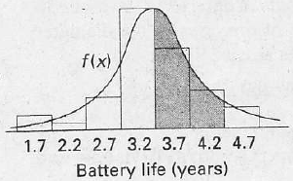
Relative Frequency Histogram
Figure 1.5 Estimating frequency distribution

Slide 13
Relative Frequency Histogram
A distribution is said to be symmetric if it can be folded along a vertical axis so that the two sides coincide. A distribution that lacks symmetry with respect to a vertical axis is said to be skewed. The distribution illustrated in Figure 1.6(a) is said to be skewed to the right, since it has a long right tail and a much shorter left tail. In Figure 1.6(b) we see that the distribution is symmetric, while in Figure 1.6(c) it is skewed to the left.

Slide 14
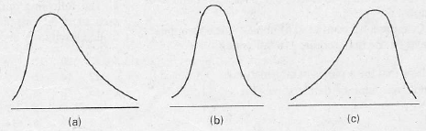
Relative Frequency Histogram
Figure 1.6 Skewness of data.

